Slide 1
Solar Cart
The search for alternative power for the shack
Don KI5AIU

Slide 2
Why?
Looking to implement a single point of ground
Very difficult in my QTH
Estimated cost > $4000
So…..

Slide 3
Alternatives
ICE generator
  Less expensive
  Noisy
  Can’t use indoors
  Maintenance (oil, filters, plugs)
  Fuel storage

Slide 4
Solar?
Integrated Solution – Anker, Bluetti, Jackary
  Good package
  Portable
  Pricey (kW/hr)
  Not very expandable
  12v not very accessible (cigarette lighter, low amps)

Slide 5
Solar
Individual components
  Pick best of class components
  Configure as needed
  Scalable, expandable
  Difficult to package cleanly

Slide 6
Solar
All-in-One
  Good package
  Reasonable price
  Select major components
  Minimum external wiring (AC in/out, DC in, PV in)

Slide 7
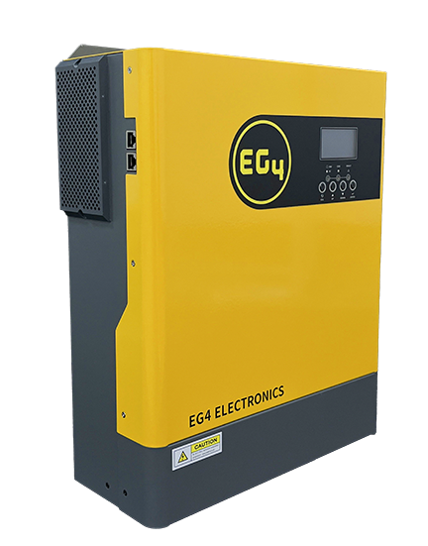
EGG4
EG4 3kW Off-Grid Inverter | 3000EHV-48 | 3000W Output | 5000W PV Input | 500 VOC Input

Slide 8
EG4 3000EHV-48
Rated Power:3,000W
Max PV Input:5000W
Battery Voltage:48V
Max Charging Current:80AMax
MPPT Operating Voltage:500VDC
Rated AC Output Power:120V

Slide 9
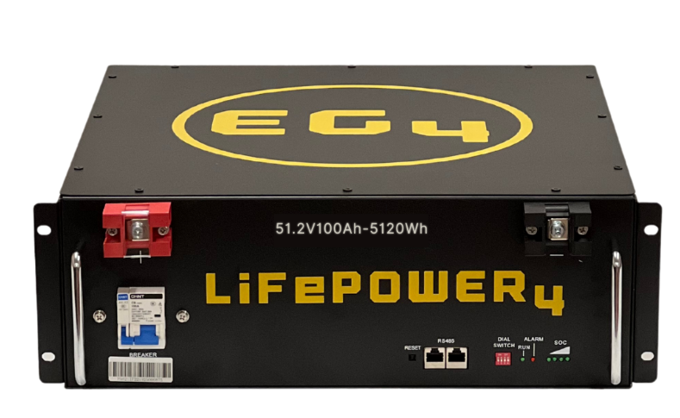
EG4 – LifePower4

Slide 10
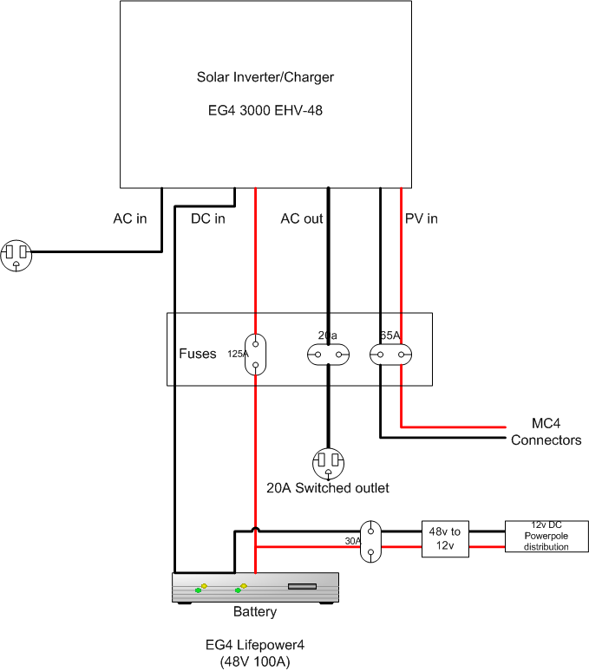
Connections

Slide 11
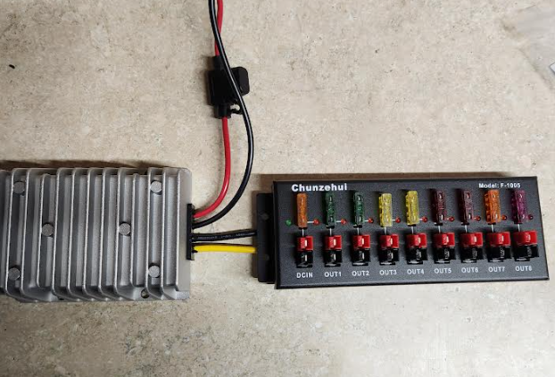
What about 12v for radio?

Slide 12
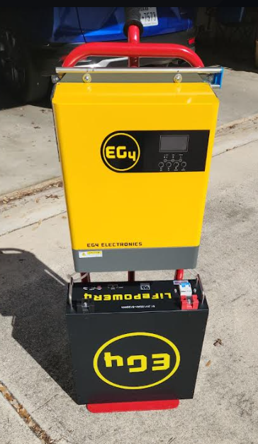
Solar Cart

Slide 13
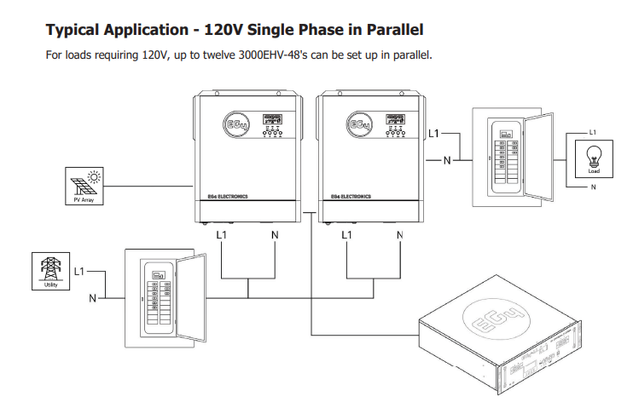
Scaleable

Slide 14
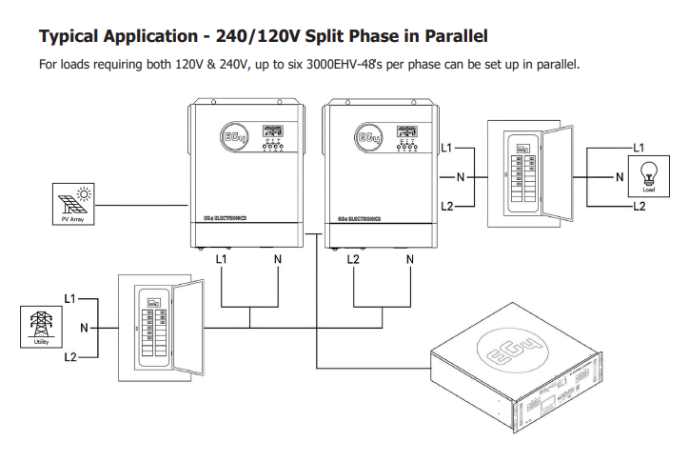
Scaleable

Slide 15
Questions?
Where: https://signaturesolar.com/
How much?
  Inverter $674
  Battery $1,259 (but there are less expensive options)

